Slide 1
FairEntry
How to Information
Washtenaw County 4-H Youth Show
Notes:
Rachel
Link to map for construction if anyone is interested:
https://maps.msu.edu/interactive/index.php

Slide 2

Michigan State University Extension programs and materials are open to all without regard to race, color, national origin, sex, gender, gender identity, religion, age, height, weight, disability, political beliefs, sexual orientation, marital status, family status or veteran status.

Slide 3
Before you register for FairEntry…
Your 4-H Online username and password
  If you forgot it, use the forgot password button at 4-H Online
The list of exhibits your 4-H’er wants to enter
  Check out the Youth Show Book for a full list of options
The Auction livestock you plan to declare and their tags numbers and RFID numbers. Breeding Animals identification numbers.
A digital copy of YQCA certificate if you are exhibiting market beef or swine and haven’t already sent it in
Notes:
Rachel
Check in between 9:00 – 11:00 a.m. If you want to have your delegates there earlier than 11:00 a.m., please change the slide to meet your delegates time.
Guys will be housed on East Holmes and Girls on West Holmes. Based on numbers, we have had girls housed in East Holmes on their own individual floors.
Please make sure your delegates know where you are located. Please share with them the physical address in order to make it easier for individual drivers and GPS.

Slide 4
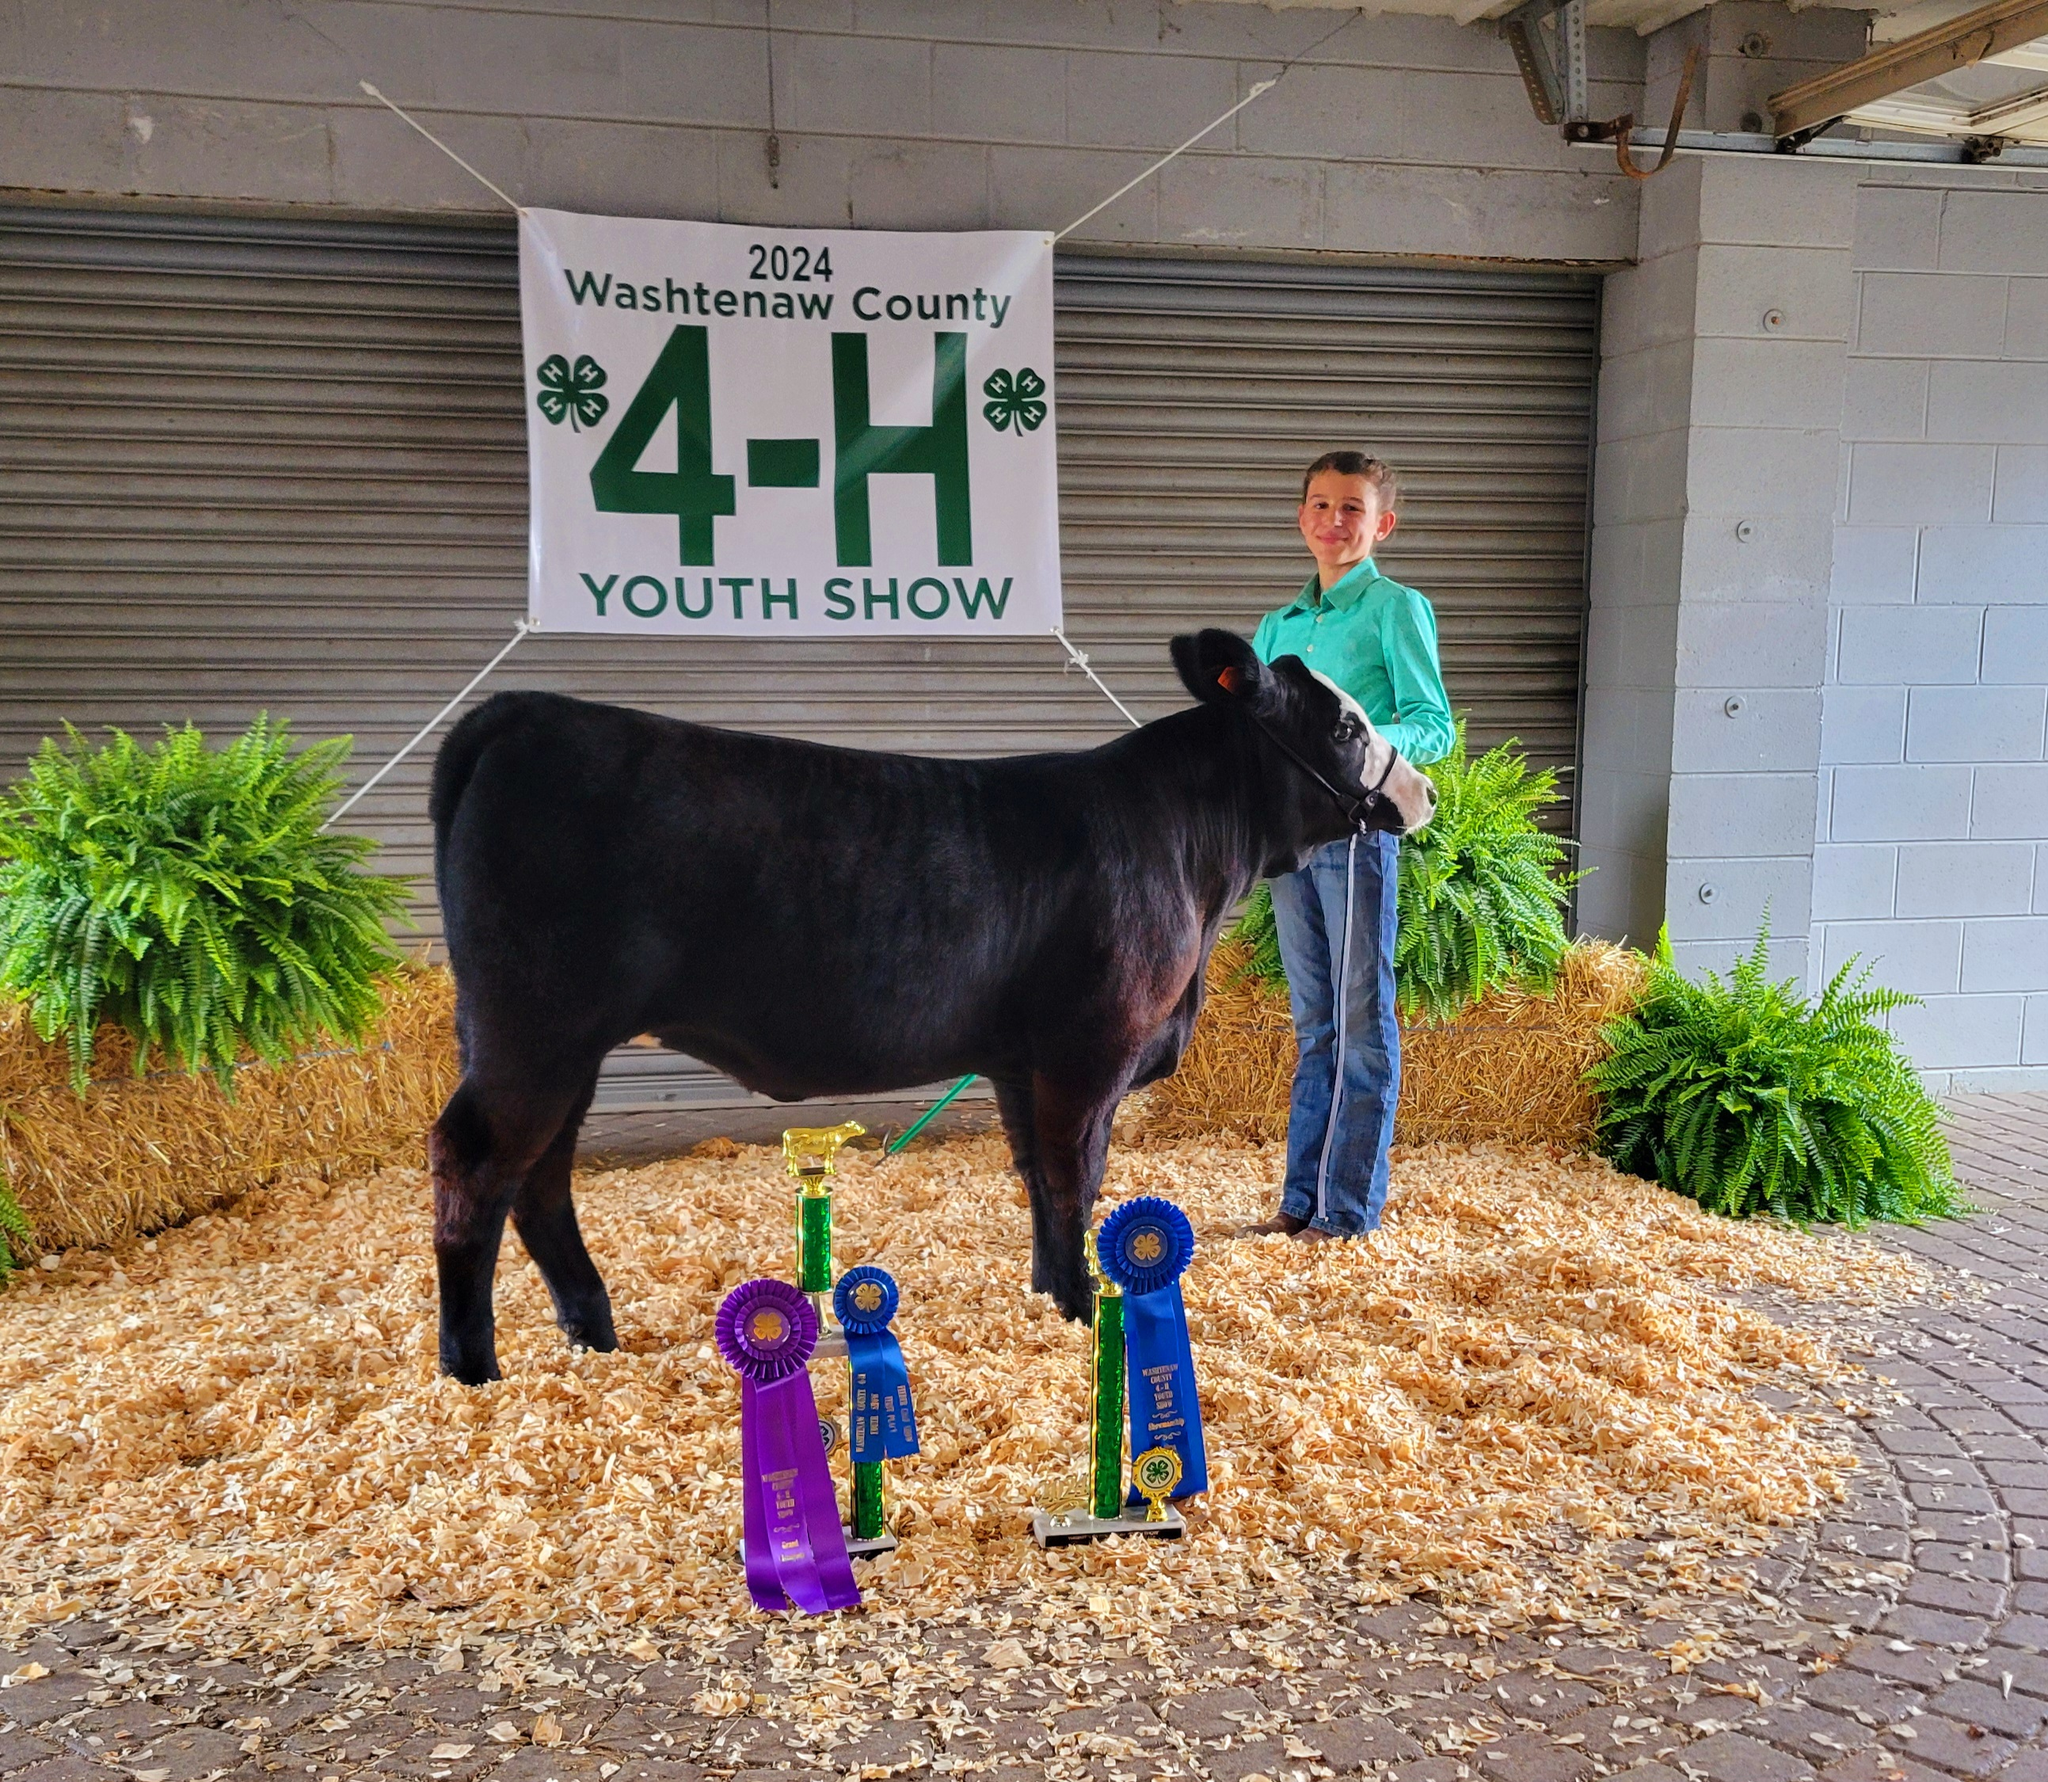
Before you register for FairEntry…
New this year
  Staff was able to enter tagged animals identification ( Washtenaw tag # and RFID/ scrapies #’s) into Fair Entry.
  Staff entered all tagged animals on all children in the family.
  You need match the tag number to the child exhibiting that animal
  DO NOT REGISTER THE SAME ANIMAL TO MORE THAN ONE CHILD
Notes:
Rachel
Check in between 9:00 – 11:00 a.m. If you want to have your delegates there earlier than 11:00 a.m., please change the slide to meet your delegates time.
Guys will be housed on East Holmes and Girls on West Holmes. Based on numbers, we have had girls housed in East Holmes on their own individual floors.
Please make sure your delegates know where you are located. Please share with them the physical address in order to make it easier for individual drivers and GPS.

Slide 5
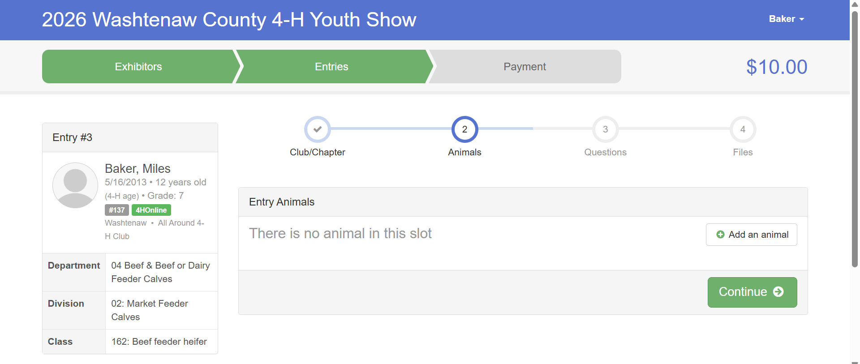

Slide 6
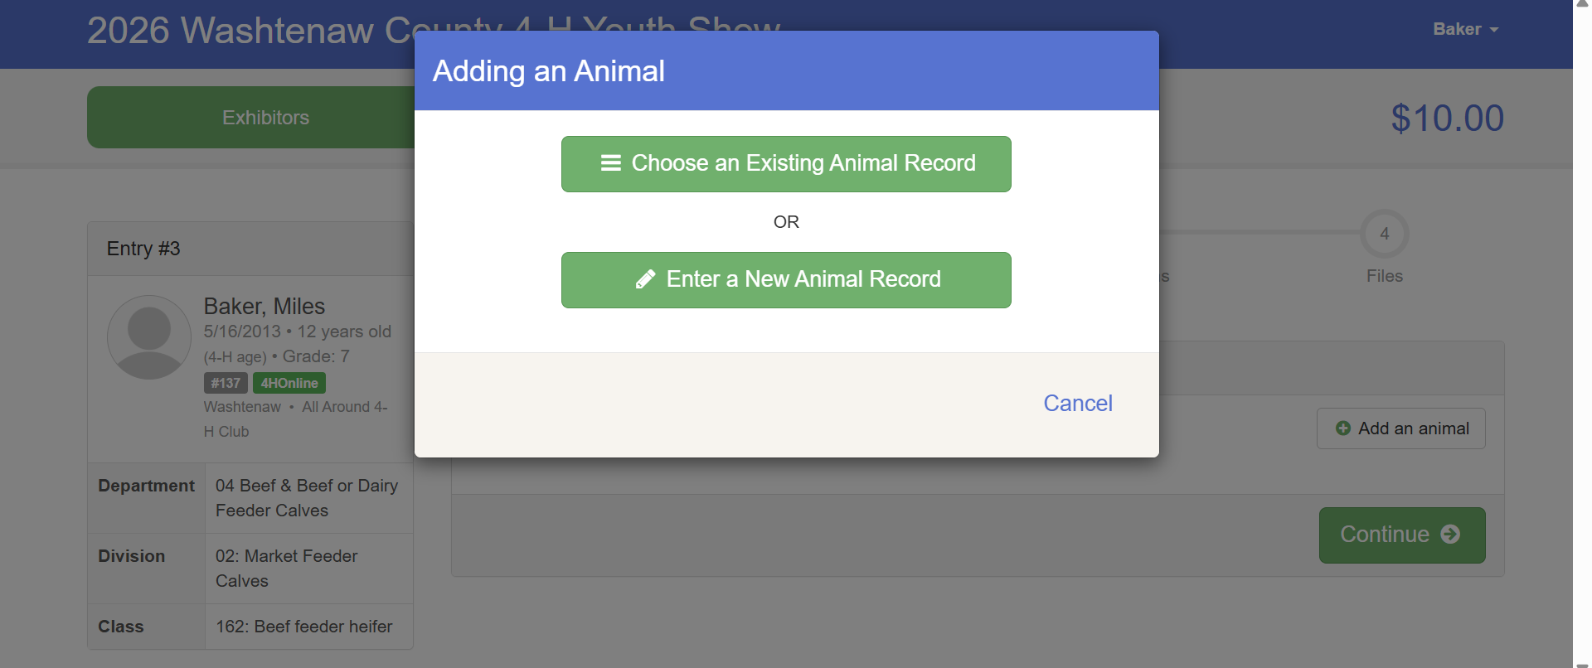

Slide 7
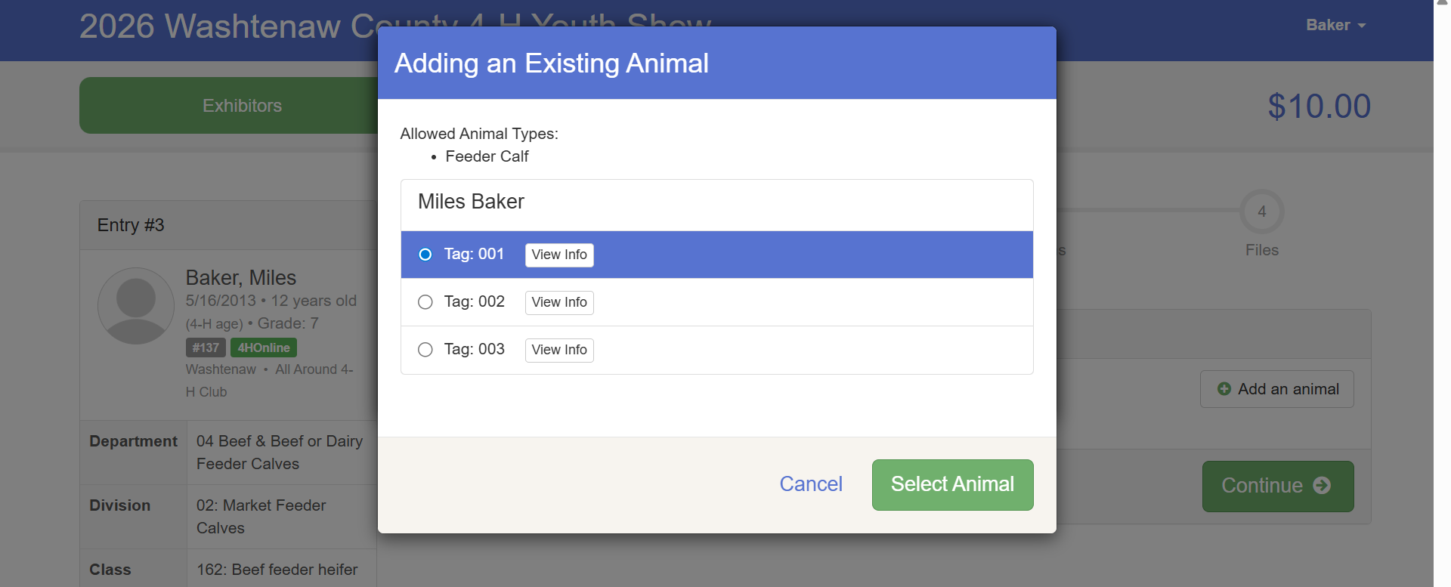

Slide 8
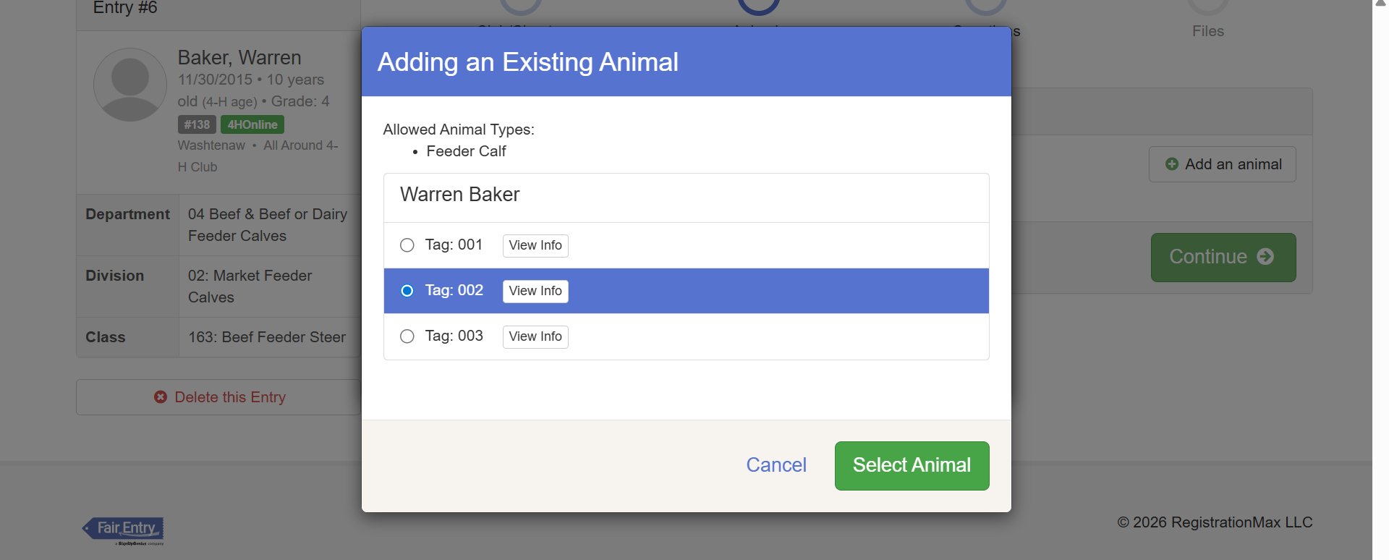
Each youth in your family will have the same list of animals.

Slide 9
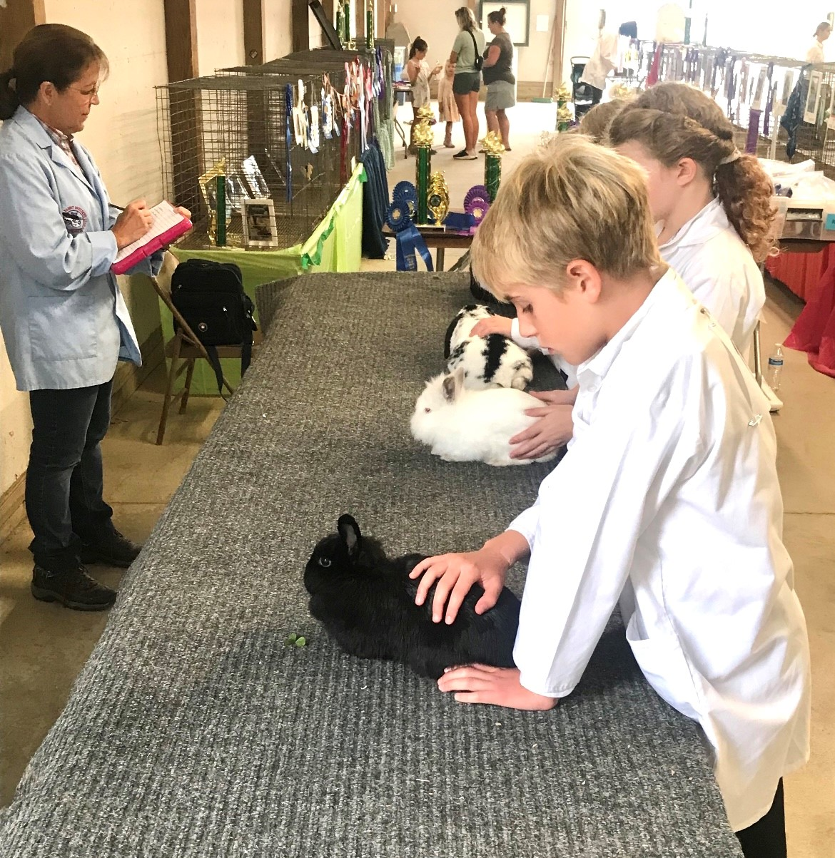
Registering Animals…
If you are registering for a pair or pen class, you will need to add each of the animals.
  To do that: You will have the “Add Animal” button and add both or however many is required for that class. Please note: Many species also require that the pair be shown as Individuals as well . These animals will need to be registered as Individuals and again as a pair. Please see Youth Show book for species specifics.
In the case of rabbits or poultry where tags are not provided or tattoos are not yet done, please enter a name or assign a number such as “Meat Pen rabbit 1, Meat pen rabbit 2 or Chicken Silkie hen, Bob the Bantam rooster”.
Notes:
Rachel
Check in between 9:00 – 11:00 a.m. If you want to have your delegates there earlier than 11:00 a.m., please change the slide to meet your delegates time.
Guys will be housed on East Holmes and Girls on West Holmes. Based on numbers, we have had girls housed in East Holmes on their own individual floors.
Please make sure your delegates know where you are located. Please share with them the physical address in order to make it easier for individual drivers and GPS.

Slide 10
Once you get started in FairEntry…
You can log into FairEntry and start your registration and log out and go back in to finish it. However, if you submit everything, you will have to wait until staff approves your entries before you can make any edits.
If you submit one child’s entries and do not add the other child, you will not be able to go back and add that child until the staff approves the first child’s entries.
Notes:
Rachel
Check in between 9:00 – 11:00 a.m. If you want to have your delegates there earlier than 11:00 a.m., please change the slide to meet your delegates time.
Guys will be housed on East Holmes and Girls on West Holmes. Based on numbers, we have had girls housed in East Holmes on their own individual floors.
Please make sure your delegates know where you are located. Please share with them the physical address in order to make it easier for individual drivers and GPS.

Slide 11
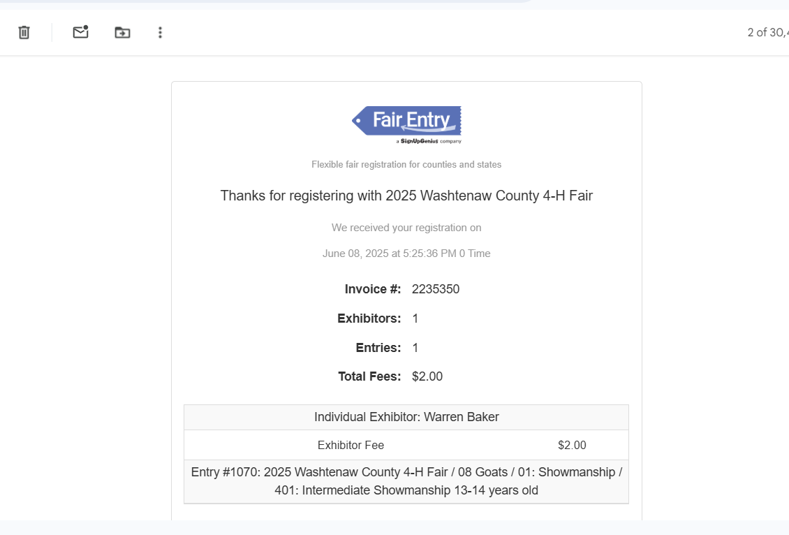
How do you know when you have registered?
Notes:
Rachel
The other side of a code of conduct is consequences for those that do not follow it.
Cover the what are the consequences mentioned below:
CONSEQUENCES If I do not follow the Michigan 4-H Code of Conduct, I know that consequences may include any or all of the following:
• Having a discussion with 4-H adults such as staff and volunteers regarding my behavior and deciding what I can do to make up for any harm done
• Notification to my parents/guardians and appropriate staff members
• Dismissal from the 4-H event at my own expense and without any refund
• Not being allowed to participate in future 4-H events
• Paying for the financial cost of damages and repairs for damage or destruction of property
• Suspension or termination of my participation in the Michigan 4-H Youth Development Program
• Being released to the nearest law enforcement agency and/or proper authorities
They cannot do something that diminishes the event for others. It's fun but we take it seriously. If they follow the Code, they can have serious fun!

Slide 12
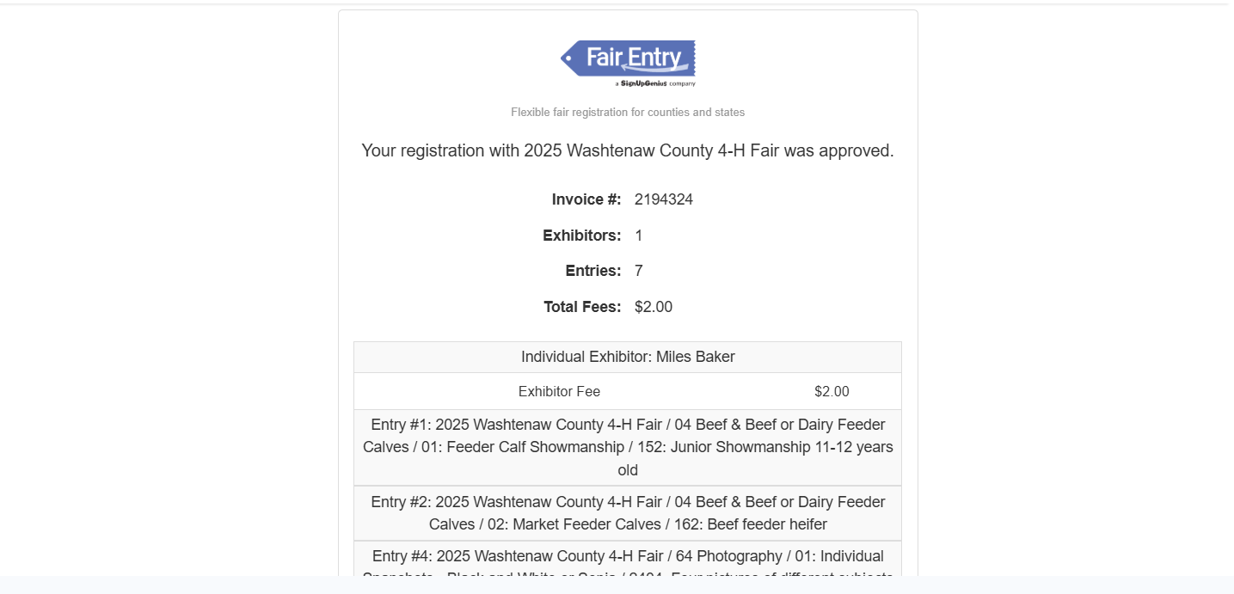
How do you know when your entries have been approved?
Notes:
Rachel
The other side of a code of conduct is consequences for those that do not follow it.
Cover the what are the consequences mentioned below:
CONSEQUENCES If I do not follow the Michigan 4-H Code of Conduct, I know that consequences may include any or all of the following:
• Having a discussion with 4-H adults such as staff and volunteers regarding my behavior and deciding what I can do to make up for any harm done
• Notification to my parents/guardians and appropriate staff members
• Dismissal from the 4-H event at my own expense and without any refund
• Not being allowed to participate in future 4-H events
• Paying for the financial cost of damages and repairs for damage or destruction of property
• Suspension or termination of my participation in the Michigan 4-H Youth Development Program
• Being released to the nearest law enforcement agency and/or proper authorities
They cannot do something that diminishes the event for others. It's fun but we take it seriously. If they follow the Code, they can have serious fun!

Slide 13
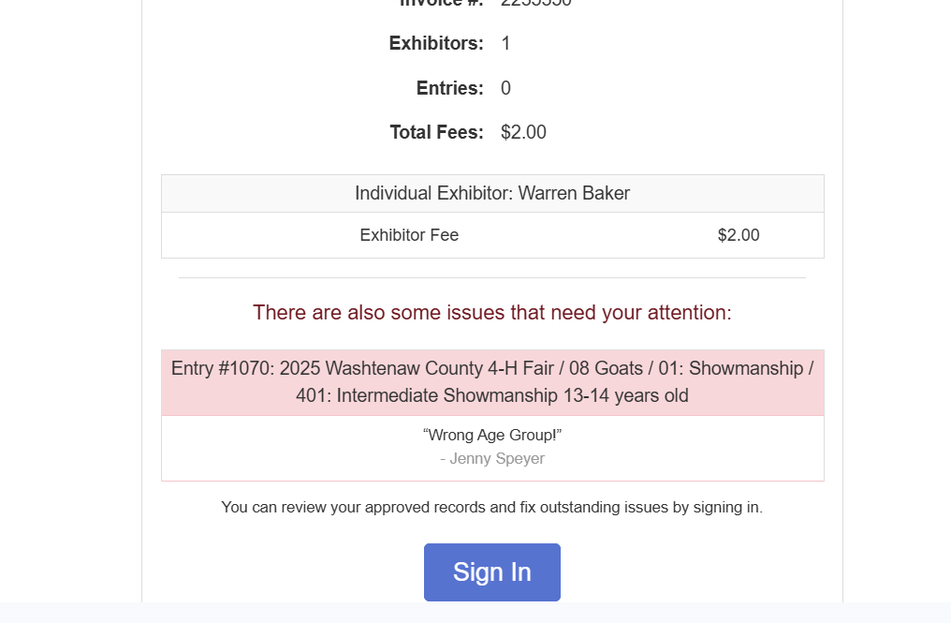
What if you made a mistake in your entries?
Notes:
Rachel
The other side of a code of conduct is consequences for those that do not follow it.
Cover the what are the consequences mentioned below:
CONSEQUENCES If I do not follow the Michigan 4-H Code of Conduct, I know that consequences may include any or all of the following:
• Having a discussion with 4-H adults such as staff and volunteers regarding my behavior and deciding what I can do to make up for any harm done
• Notification to my parents/guardians and appropriate staff members
• Dismissal from the 4-H event at my own expense and without any refund
• Not being allowed to participate in future 4-H events
• Paying for the financial cost of damages and repairs for damage or destruction of property
• Suspension or termination of my participation in the Michigan 4-H Youth Development Program
• Being released to the nearest law enforcement agency and/or proper authorities
They cannot do something that diminishes the event for others. It's fun but we take it seriously. If they follow the Code, they can have serious fun!

Slide 14

What if you made a mistake in your entries?
You can log back into your account and add or modify additional entries. If you got a rejected entry, you will have to modify the entry and submit it again.
Notes:
Rachel
The other side of a code of conduct is consequences for those that do not follow it.
Cover the what are the consequences mentioned below:
CONSEQUENCES If I do not follow the Michigan 4-H Code of Conduct, I know that consequences may include any or all of the following:
• Having a discussion with 4-H adults such as staff and volunteers regarding my behavior and deciding what I can do to make up for any harm done
• Notification to my parents/guardians and appropriate staff members
• Dismissal from the 4-H event at my own expense and without any refund
• Not being allowed to participate in future 4-H events
• Paying for the financial cost of damages and repairs for damage or destruction of property
• Suspension or termination of my participation in the Michigan 4-H Youth Development Program
• Being released to the nearest law enforcement agency and/or proper authorities
They cannot do something that diminishes the event for others. It's fun but we take it seriously. If they follow the Code, they can have serious fun!

Slide 15
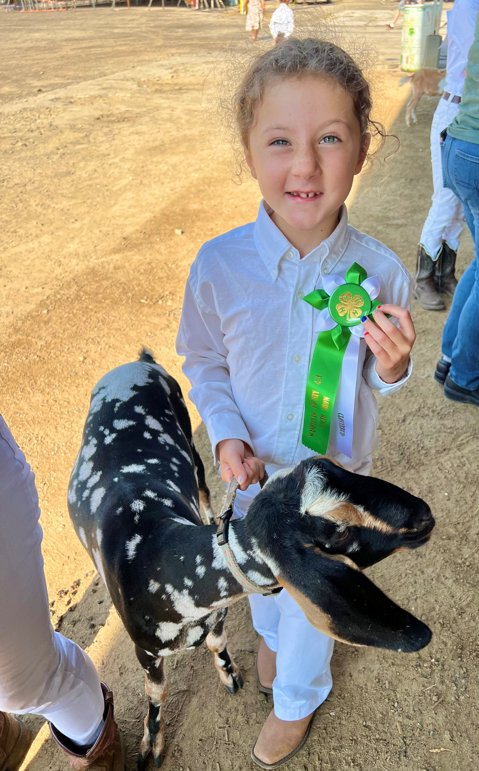
Deadline is Friday June 12th at 11:59 pm
Do NOT wait until the last minute to register
If you have issues or questions this week, reach out to Amy, Jenny, or Melissa at the 4-H Office
4-H Staff will be available until 5 pm on Friday to help with questions.
There is a $50 late fee if you don’t register or want to make modifications after the deadline.
Notes:
Rachel
The other side of a code of conduct is consequences for those that do not follow it.
Cover the what are the consequences mentioned below:
CONSEQUENCES If I do not follow the Michigan 4-H Code of Conduct, I know that consequences may include any or all of the following:
• Having a discussion with 4-H adults such as staff and volunteers regarding my behavior and deciding what I can do to make up for any harm done
• Notification to my parents/guardians and appropriate staff members
• Dismissal from the 4-H event at my own expense and without any refund
• Not being allowed to participate in future 4-H events
• Paying for the financial cost of damages and repairs for damage or destruction of property
• Suspension or termination of my participation in the Michigan 4-H Youth Development Program
• Being released to the nearest law enforcement agency and/or proper authorities
They cannot do something that diminishes the event for others. It's fun but we take it seriously. If they follow the Code, they can have serious fun!

Slide 16
Are you better at learning from videos?
https://fairentry.zendesk.com/hc/en-us/articles/217431057-Resources-for-Families-Making-Entries
Notes:
Rachel/Janelle/Kea

Slide 17
Questions? Comments? Concerns?
Jenny Speyer, 4-H Program Instructor speyerje@msu.edu
Amy Harris,4-H Program Coordinator harr1976@msu.edu
Melissa Gillespie
  Washtenaw County MSU Extension Support Staff
  734-997-1678
Notes:
Rachel/Janelle/Kea

Slide 18
Michigan State University Extension programs and materials are open to all without regard to race, color, national origin, sex, gender, gender identity, religion, age, height, weight, disability, political beliefs, sexual orientation, marital status, family status or veteran status.

